Slide 1

STIX FMA Fun Finder
Johan Bester
Savvy Coders June 2020 Cohort

Slide 2
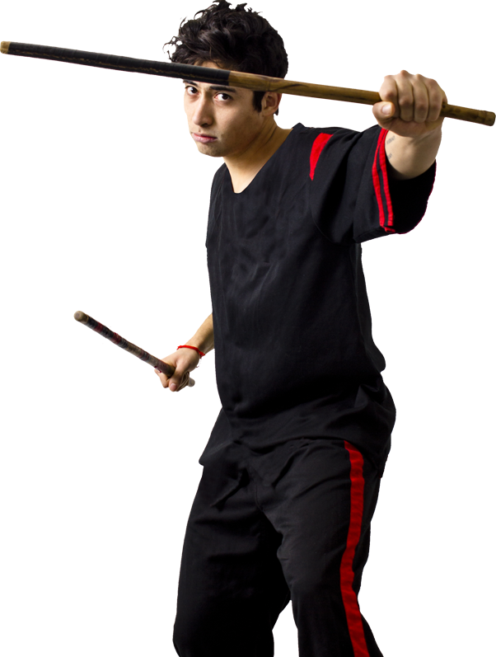
Filipino Martial Arts (FMA)
One of the fastest growing sports
FMA is easy for anybody to learn
One of the most effective self-defense systems
Finding FMA venues & events is hard

Slide 3
STIX FMA Fun Finder
Only one other option in the market
My solution is better, It’s unique and free to use
Will feature info on most venues & events in N.A.
STIX will help FMA practitioners find each other Provide clubs and schools more business Grow the FMA sport in general

Slide 4
STIX Project Management
Trello Board – Kanban style project board (https://trello.com/b/zWx1qQFB/stix-fma-fun-finder)
Github Repository (https://github.com/JohanBester/JBBesterCapstoneProject)
Documents like UI / UX - Mockups and project plan in GitHub (https://github.com/JohanBester/JBBesterCapstoneProject/tree/master/DOCS)

Slide 5
STIX Project Build
Used VS Code and Node
HTML, CSS, vanilla JavaScript
Converted to a JS Single Page Application (SPA)
Use API, Firebase, FormSpree & JSON store
Hosted on Netlify

Slide 6
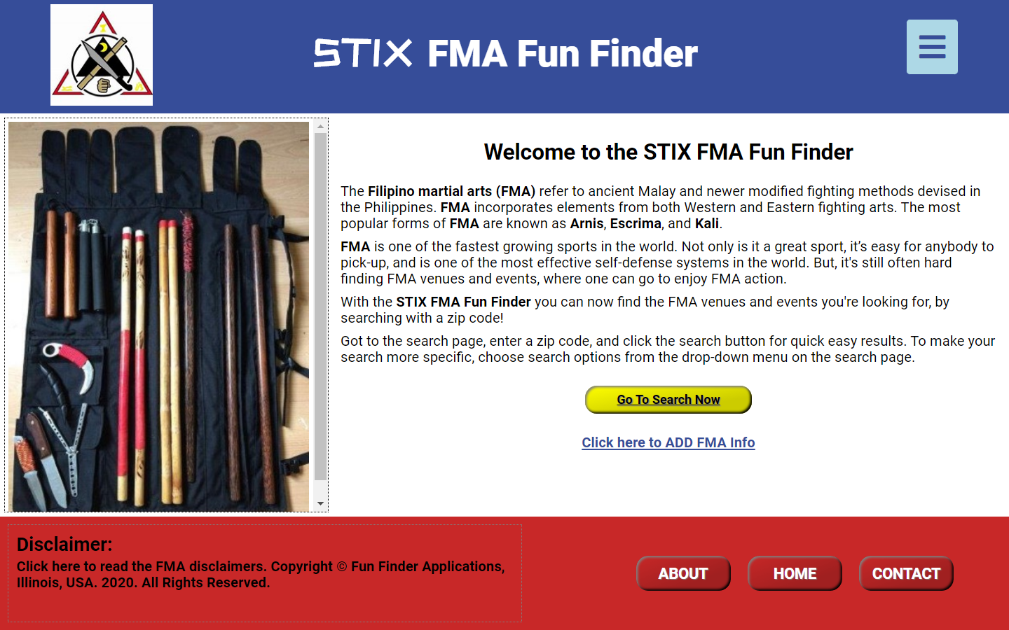
So, let’s take a look at the STIX FMA Fun Finder
https://stix-fma-funfinder.netlify.app/

Slide 7
Obstacles and challenges
The greatest obstacle highlights the importance of the STIX app
UI / UX Design paradigm
SPA structure & JavaScript Frameworks

Slide 8
Concept future
There’s more … Fun Finder is a concept!
Next: Registered users section with full login
Future: Online Database interface for updates
Future: Expanded info on venues and events
Possible: Sponsors ads in application

Slide 9
Any Questions Please?

Slide 10

Johan Bester Creator of the Fun Finder APP
Front-end Developer
Linkedin.com/in/johanbester/
Johan.bester@yahoo.com
618-670-3643

